Slide 1
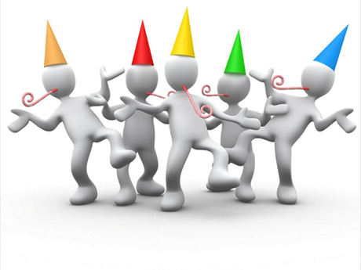
CARROLLTON GROUP ANNIVERSARY CELEBRATION
SUNDAY, OCTOBER 10, 2021
1:30pm ~ Potluck
2:30pm ~ Group History
2:45pm ~ Guest Speaker: Jeannette M. (Georgetown Group)
3:45pm ~ Fellowship and Desserts
Meat/drinks provided by Carrollton Group
Bring your favorite side dish or dessert
Carrollton Group
1039 N. Interstate 35E
Carrollton, TX 75006
972-242-5267

